Slide 1
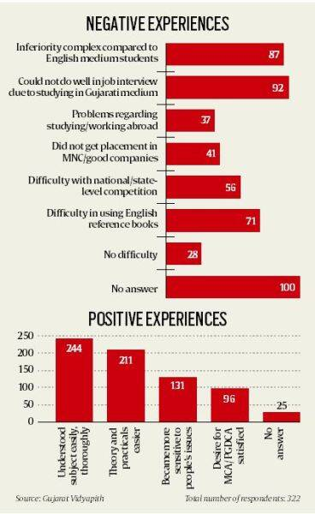
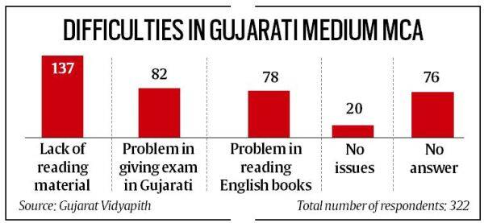
‘Better grasp, but lack of ecosystem: Survey by Gujarat Vidyapith puts spotlight on advantages, challenges of teaching technical courses in mother tongue’
Table 1: ‘Difficulties’
Table II: ‘Negative Experiences’
Notes:
https://indianexpress.com/article/education/better-grasp-but-lack-of-ecosystem-gujarati-language-tech-students-8105873/

Slide 2
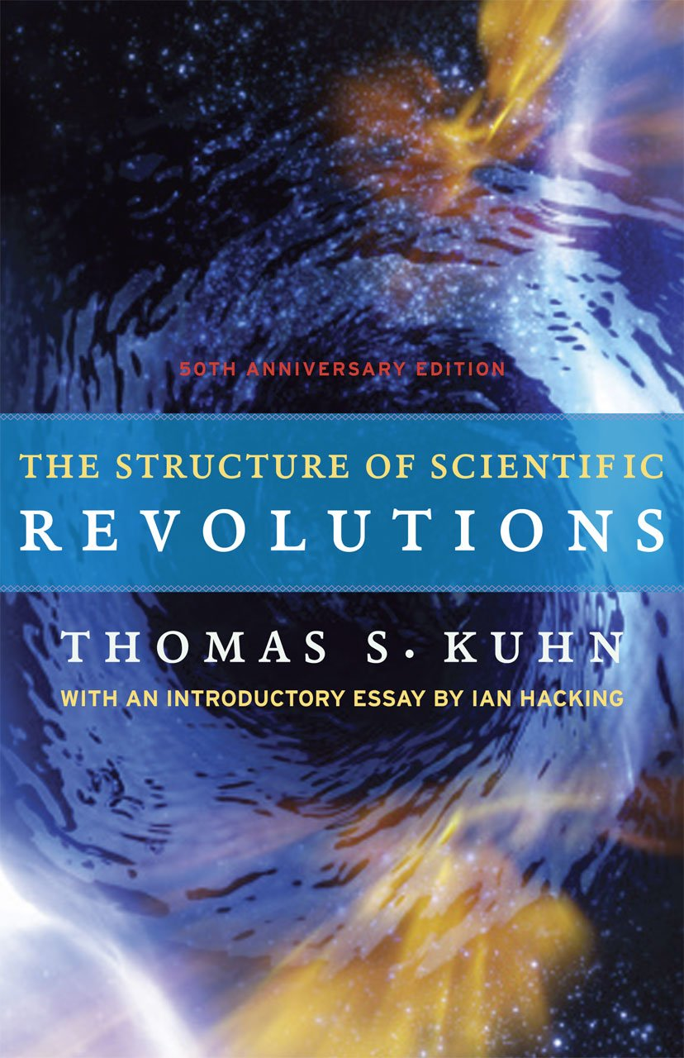
History, or Philosophy of Science?
The Structure of Scientific Revolutions
(1962)
Notes:
Image source: https://images-na.ssl-images-amazon.com/images/I/51tgYAVloIL._SX321_BO1,204,203,200_.jpg

Slide 3
The tendency to see the past purely in terms of the present. “…to see moves in the direction of what we now believe to be the truth as more rational, more natural, and less needing of causal explanation than opposition to what we now believe.” (12) Why is this wrong? History is not a single line leading up to ‘now’: there is chance, there are surprises, ‘irregular changes.’
What is “Whig History”?
Notes:
Image source: https://images-na.ssl-images-amazon.com/images/I/51tgYAVloIL._SX321_BO1,204,203,200_.jpg

Slide 4
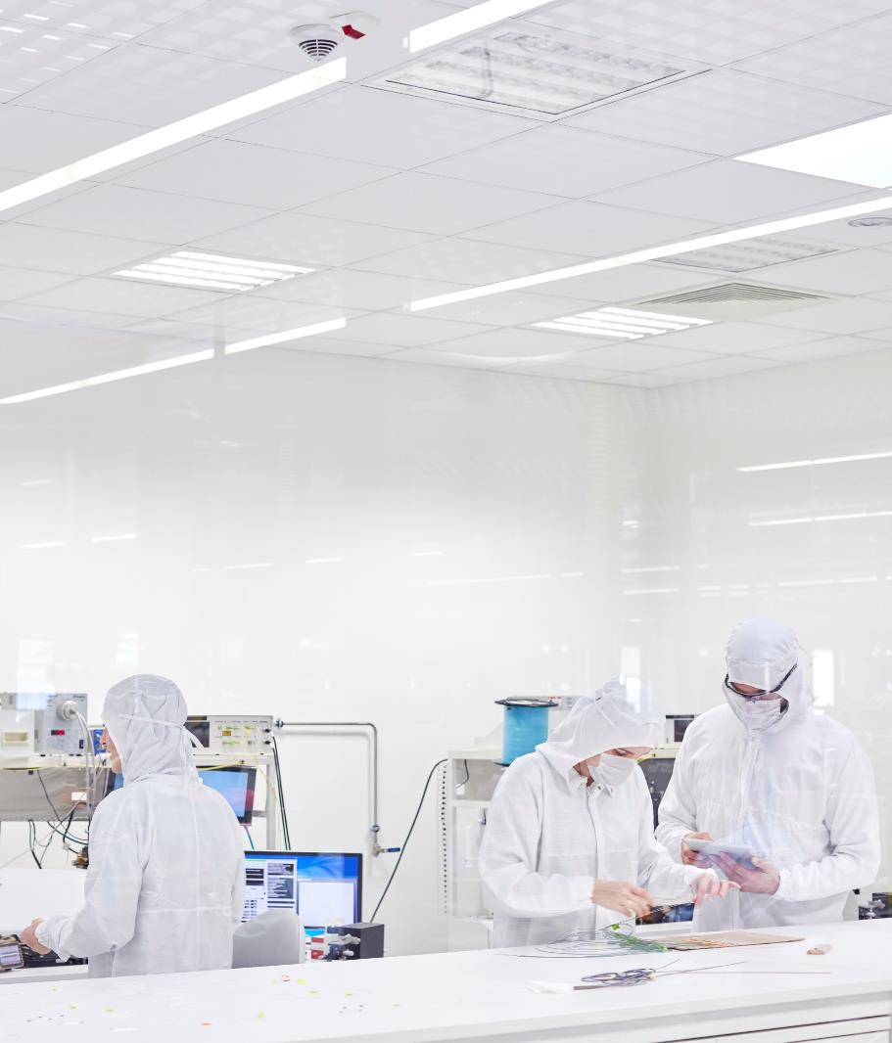
Vocabulary: Kuhn
A New Structure to challenge “Whig History”

Slide 5
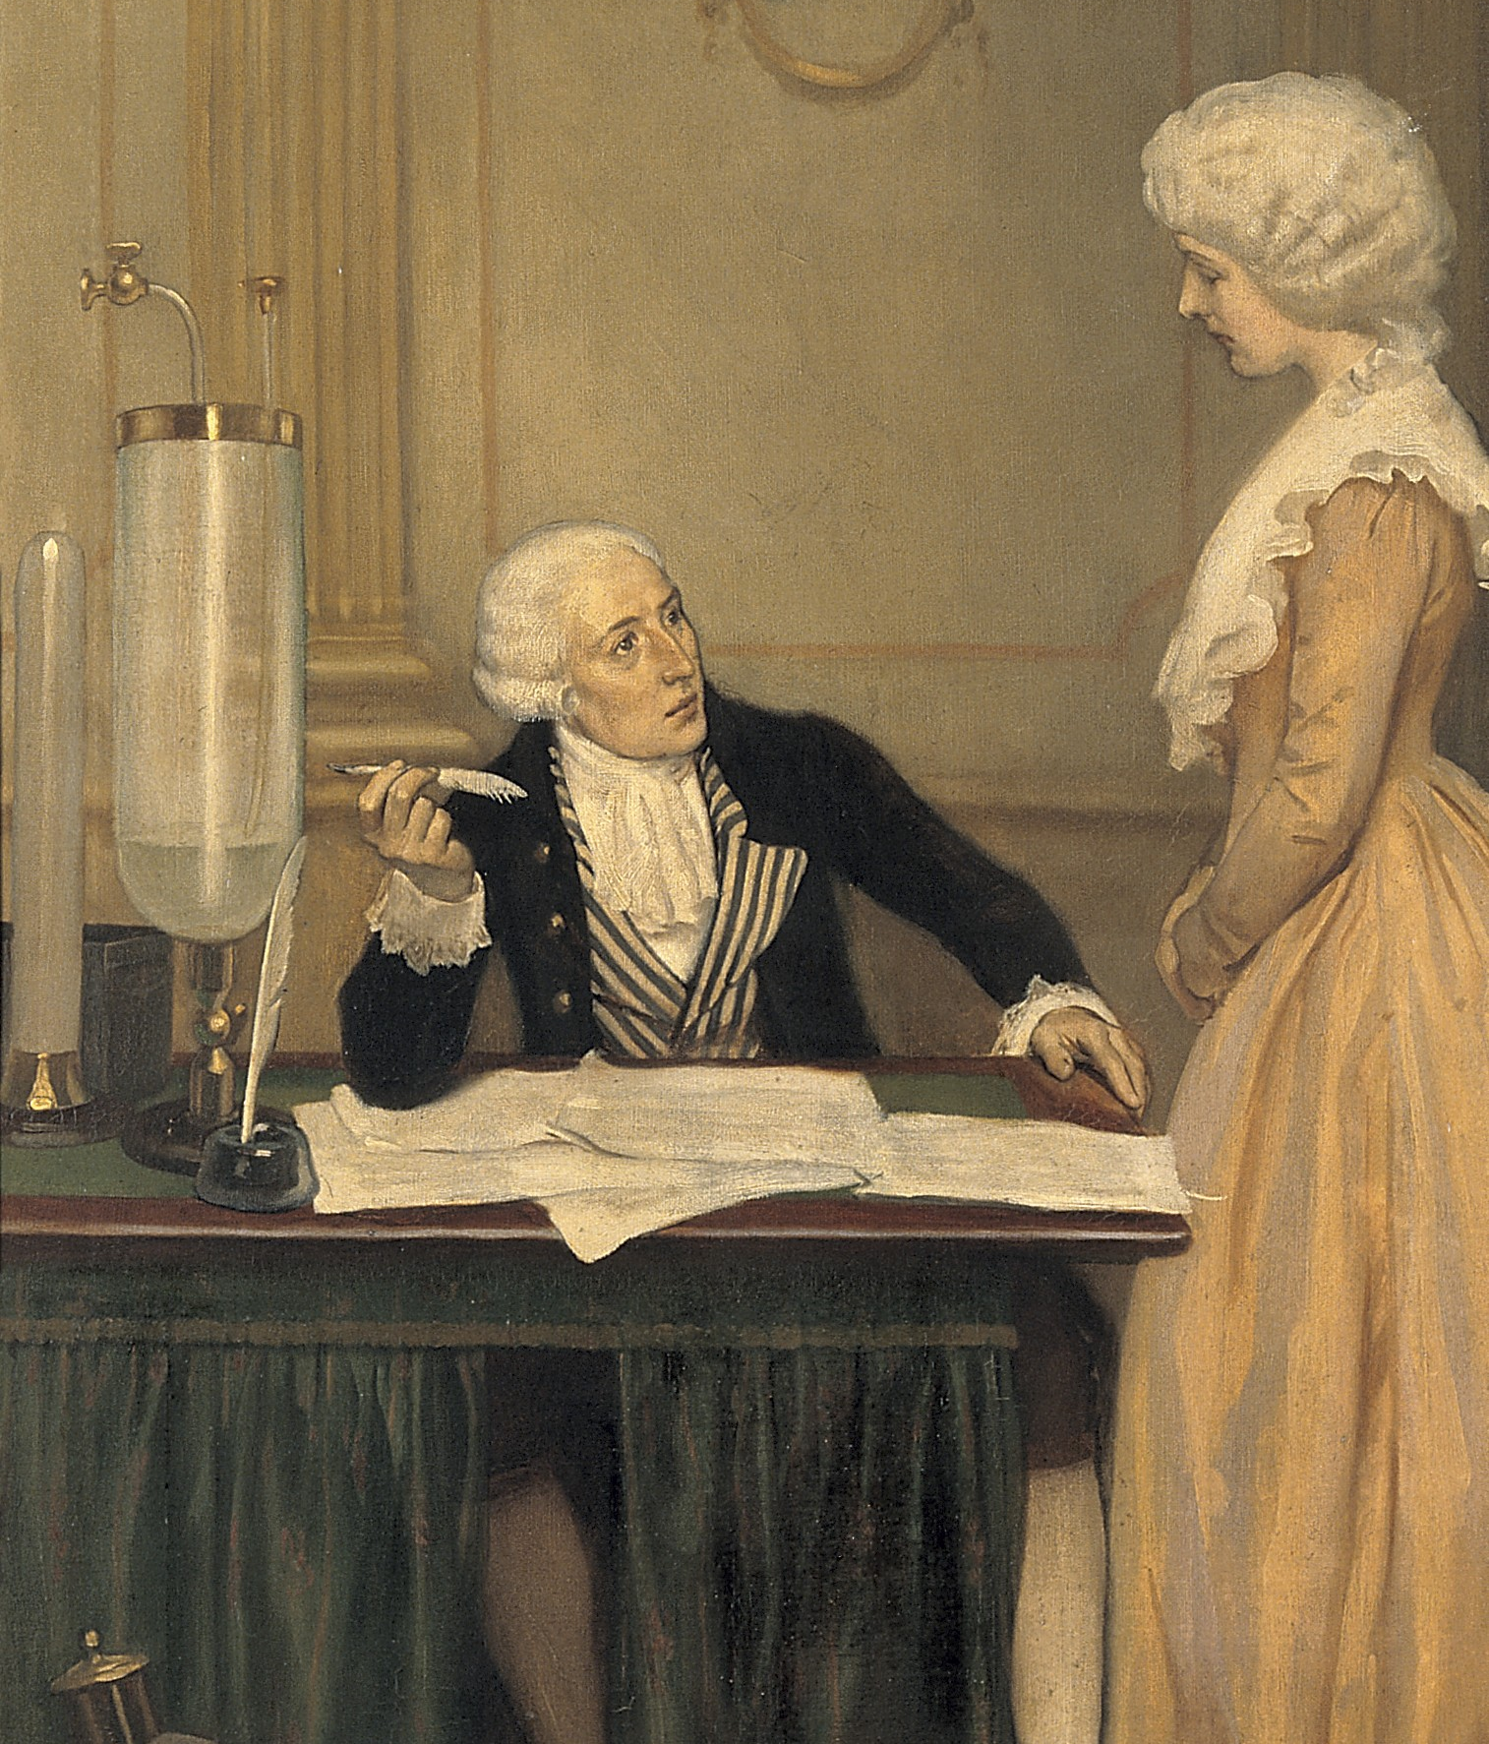
Normal Science
Worldview + Form of Life
Paradigm : an exemplary theory & practice of science (eg. Lavoisier)
Puzzle-Solving : Regular scientific activity within a paradigm.
Worldview : How to make sense of what you see/observe.
Form of Life : How to practice science
Notes:
Image: https://upload.wikimedia.org/wikipedia/commons/b/bf/Lavoisier_explaining_to_his_wife_the_result_of_his_experimen_Wellcome_V0018151.jpg

Slide 6
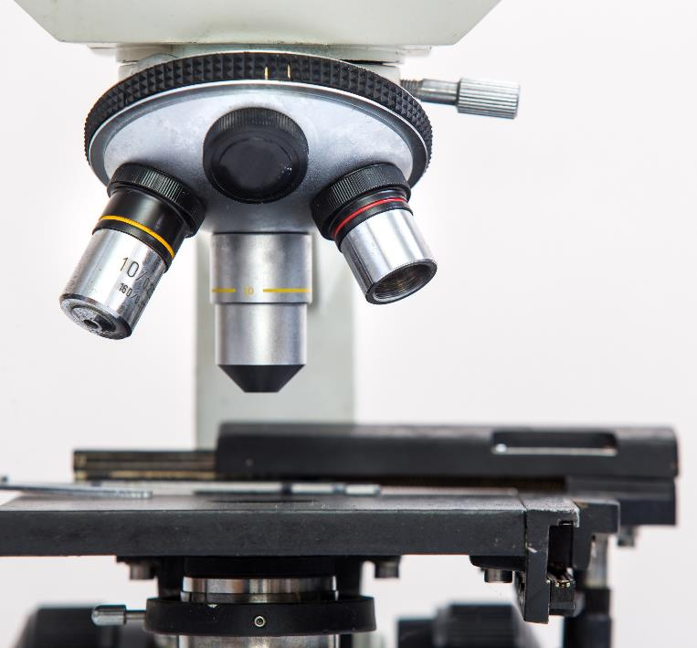
Crisis + Change
Paradigm Shift
What happens with a ‘scientific revolution’?
Frameworks are called into question, problems change, vocabularies change.
How you see, what you see and describe… change radically: observation depends on theory
Incommensurability: The conversation between practitioners of different paradigms may break down, because they are seeing, describing and tracking very different ‘phenomena.’ (Eg. Newton: scientist and alchemist? Medical ‘reasons’ for cold and cough)

Slide 7
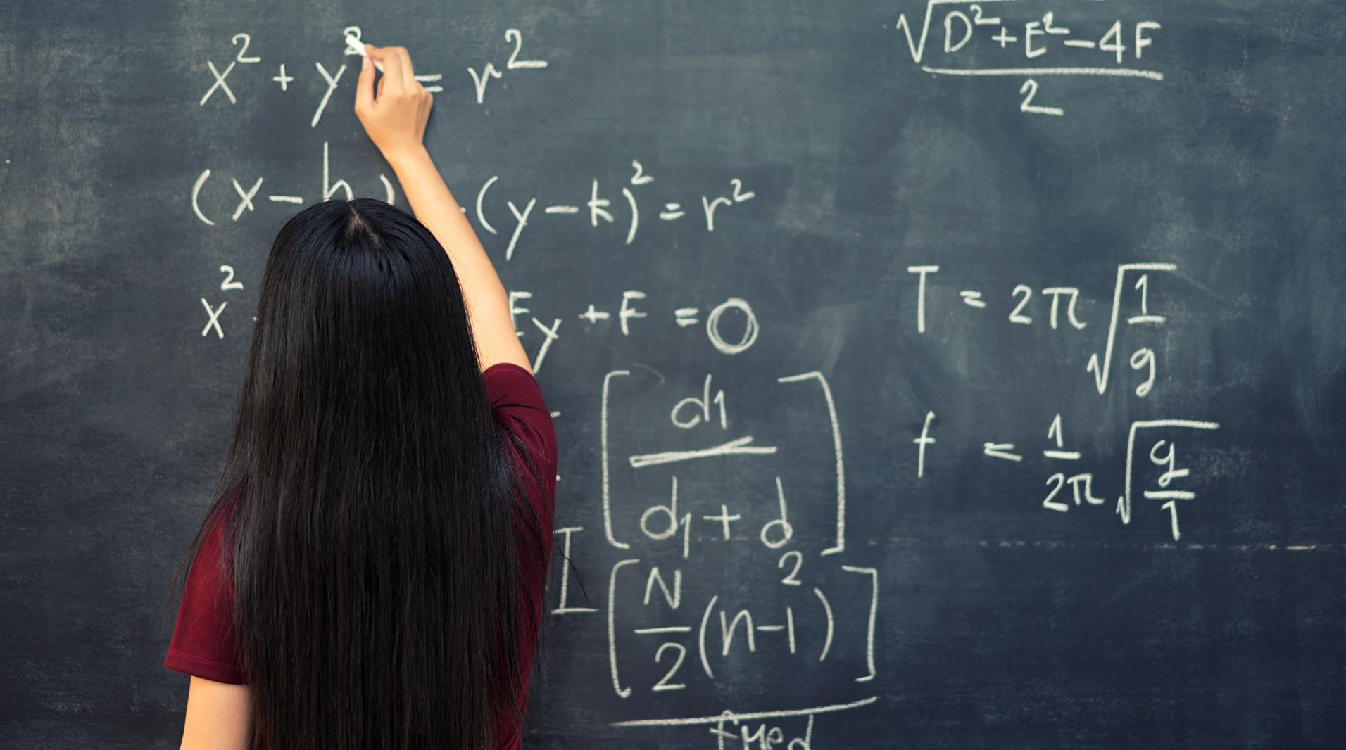
Large image
Responses to Kuhn’s Argument

Slide 8
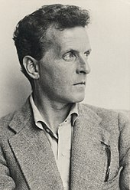
Discontinuity in Science
What do paradigm shifts mean?
Science maintains stability through change by being dis-unified, like a thread as described by Wittgenstein (1958): “the strength of the thread does not reside in the fact that some one fibre runs through its whole length, but in the overlapping of many fibres.”’
(Sismondo, 18)
Notes:
Image source: https://en.wikipedia.org/wiki/Ludwig_Wittgenstein#/media/File:Ludwig_Wittgenstein.jpg

Slide 9
Incommensurability?
Trading Zone
Boundary Object
How do people from different places, speaking different languages and from different cultural milieus manage to interact with each other?
There may be people who are familiar with both disciplines/languages (like Kuhn, and Peter Galison).
Metaphors developed by Galison, historian and philosopher of science (Image and Logic, 1997).
How do different groups of ‘experts’ communicate within an institution?
Not languages but ‘objects’ become a common site for conversation and collaboration
These are different ‘social worlds’ brought together by, say, the ‘record of specimens’ in a museum.
Concept developed by Star and Griesemer (“Institutional Ecology, 'Translations' and Boundary Objects”, 1989)

Slide 10
Teleology Normative Formalist
General Vocabulary
Terms to think about

Slide 11
Creative Requirement Humanity Facilitates Successful Through/Throw Interactive Misuse MODERN Development Living Standard Promotes Adequately
Spelling Errors
Writing assignment

